Slide 1

Khulna University of Engineering & Technology
Course: CSE 4208
Course Title: Computer Graphic Laboratory
Cafeteria Graphics Design
Presented by
Israt Tasnim Esha
Roll: 1907090

Slide 2
Outline
Objectives
Introduction
Features
Visual Representation of the Project
Conclusion

Slide 3
Objectives
To gain proficiency in OpenGL 3.3 by designing a dynamic 3D scene inspired by the Hogwarts castle.
To develop and integrate various complex 3D shapes, such as cubes, spheres, half-spheres, triangles, trapeziums, pyramids, cylinders, and toruses, into the project.
To learn and implement Bezier curves to enhance the project.

Slide 4
Introduction
A detailed cafeteria is created, incorporating various interior design elements using polygons, cones, and Bezier curves.
Features a comfortable theater space equipped with sofas and a working ceiling fan for added realism.
A compact kitchen area is designed as part of the project.
A fully operational lift system is implemented to showcase dynamic functionality.

Slide 5
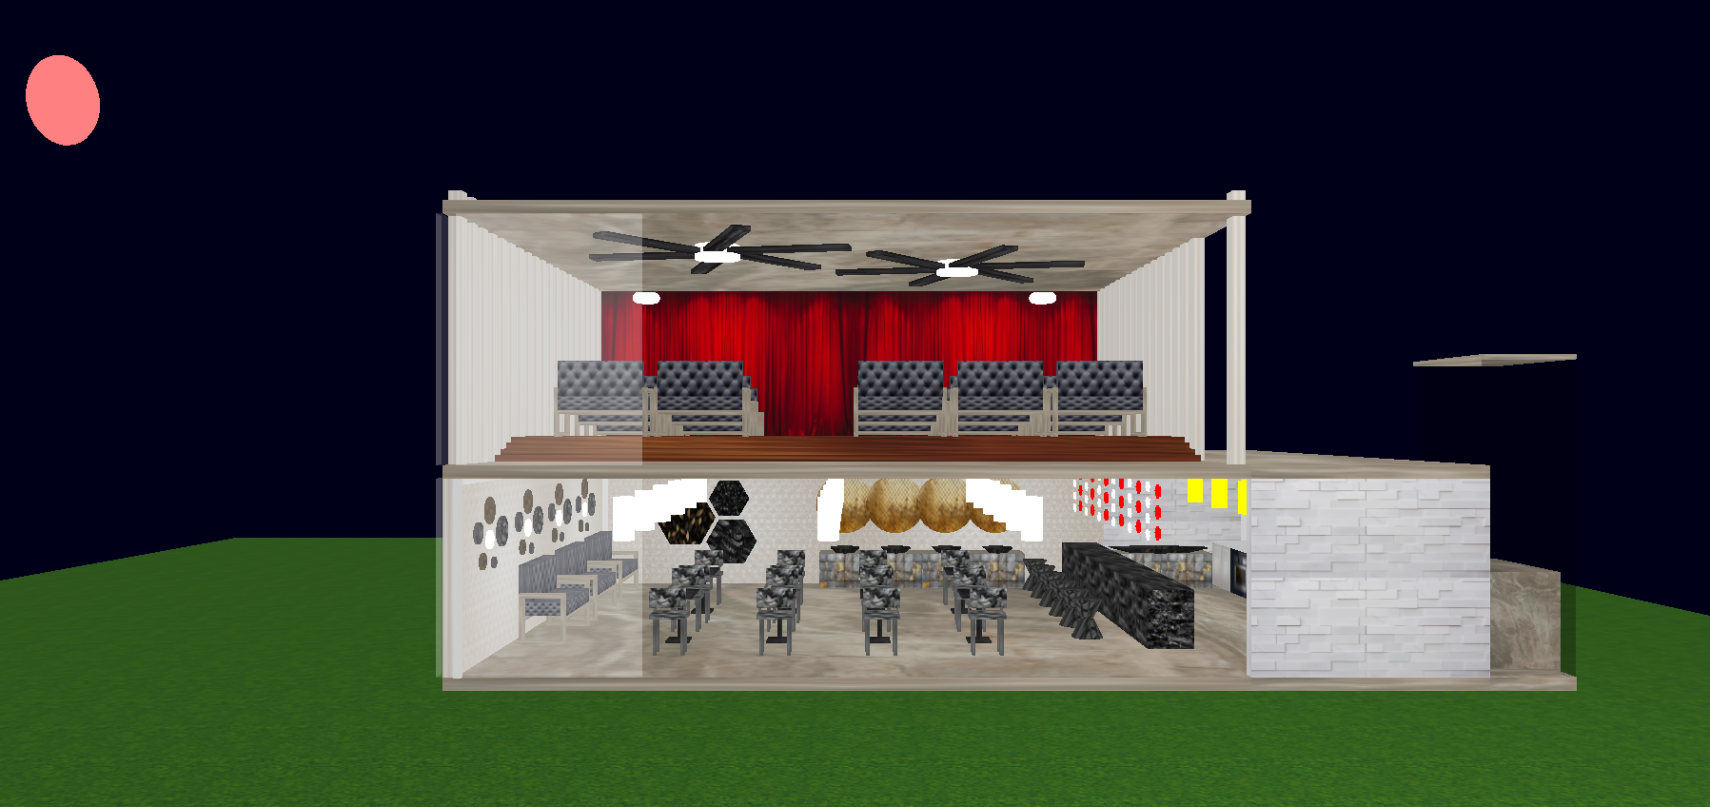
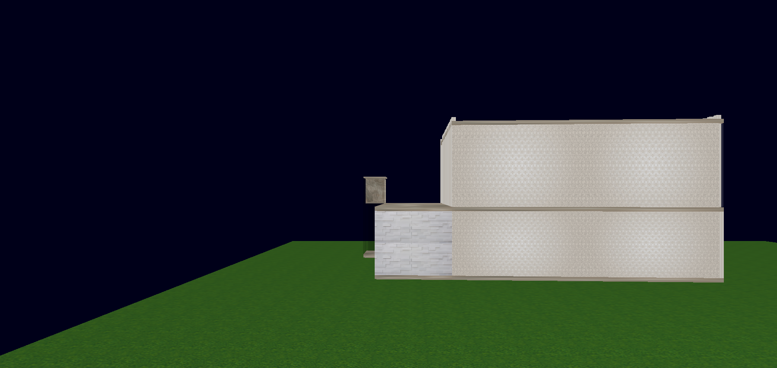
Features (Views)
Front view and back view.
Fig 1.1: Front view
Fig 1.2: Back view

Slide 6
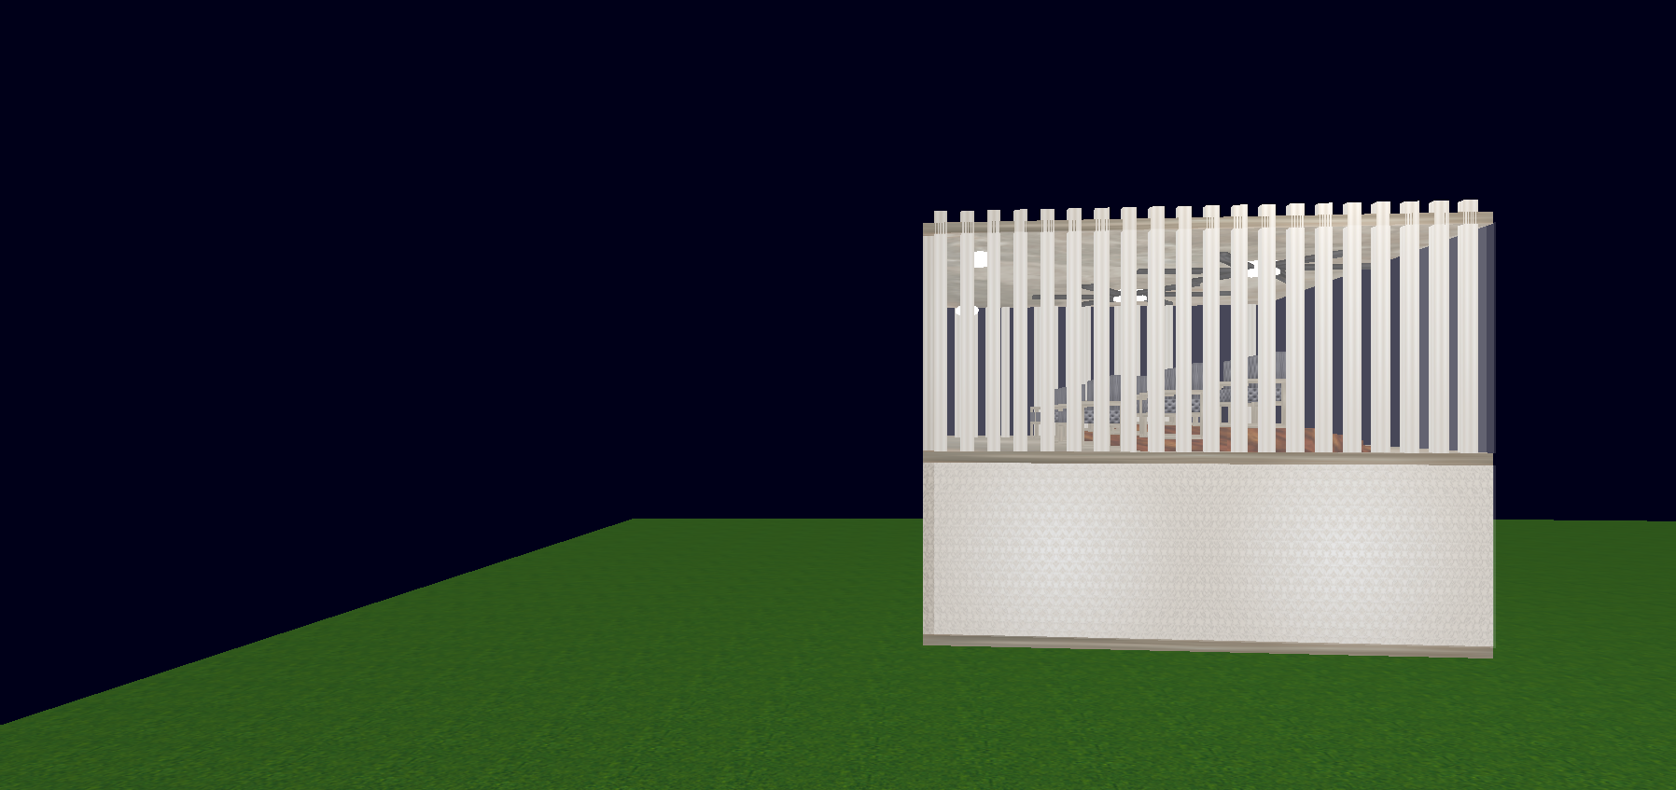
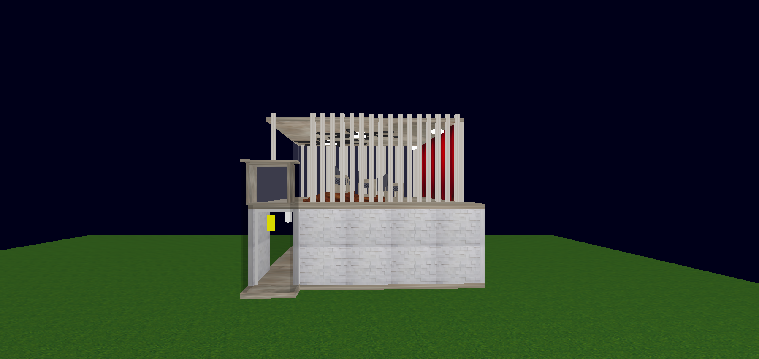
Features (Views) Cont’d
Left view and right view.
Fig 1.3: Left view
Fig 1.4: Right view

Slide 7
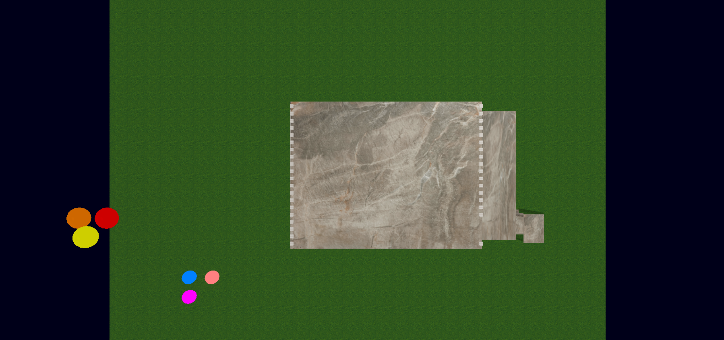

Features (Views) Cont’d
Top view and bottom view.
Fig 1.5: Top view
Fig 1.6: Bottom view

Slide 8
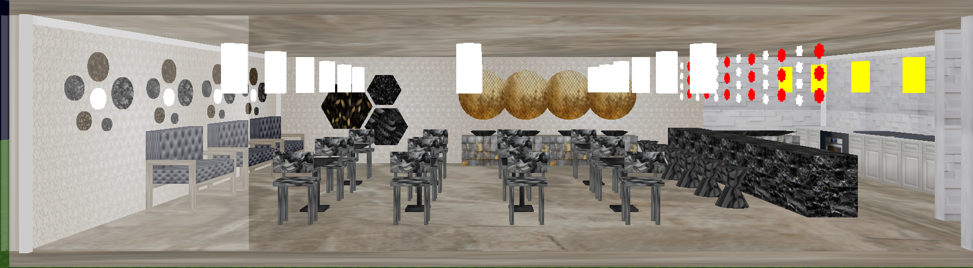
Features (Spots)
Cafeteria and kitchen view.
Fig 2.1: Cafeteria and kitchen

Slide 9
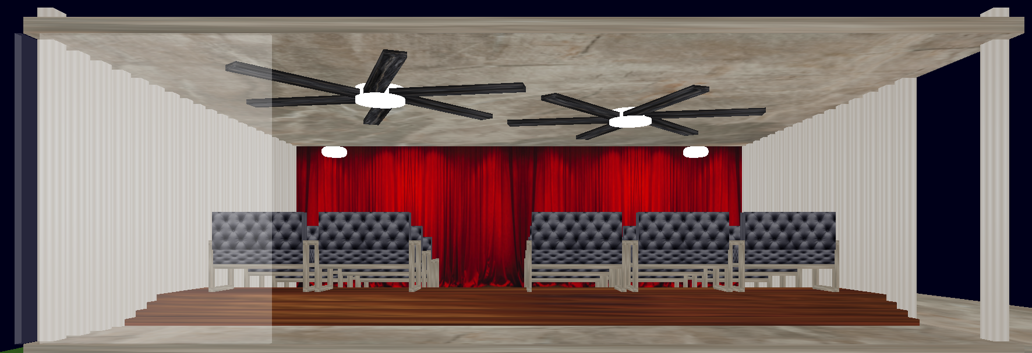
Features (Spots) Cont’d
Theater view.
Fig 2.2: Theater

Slide 10
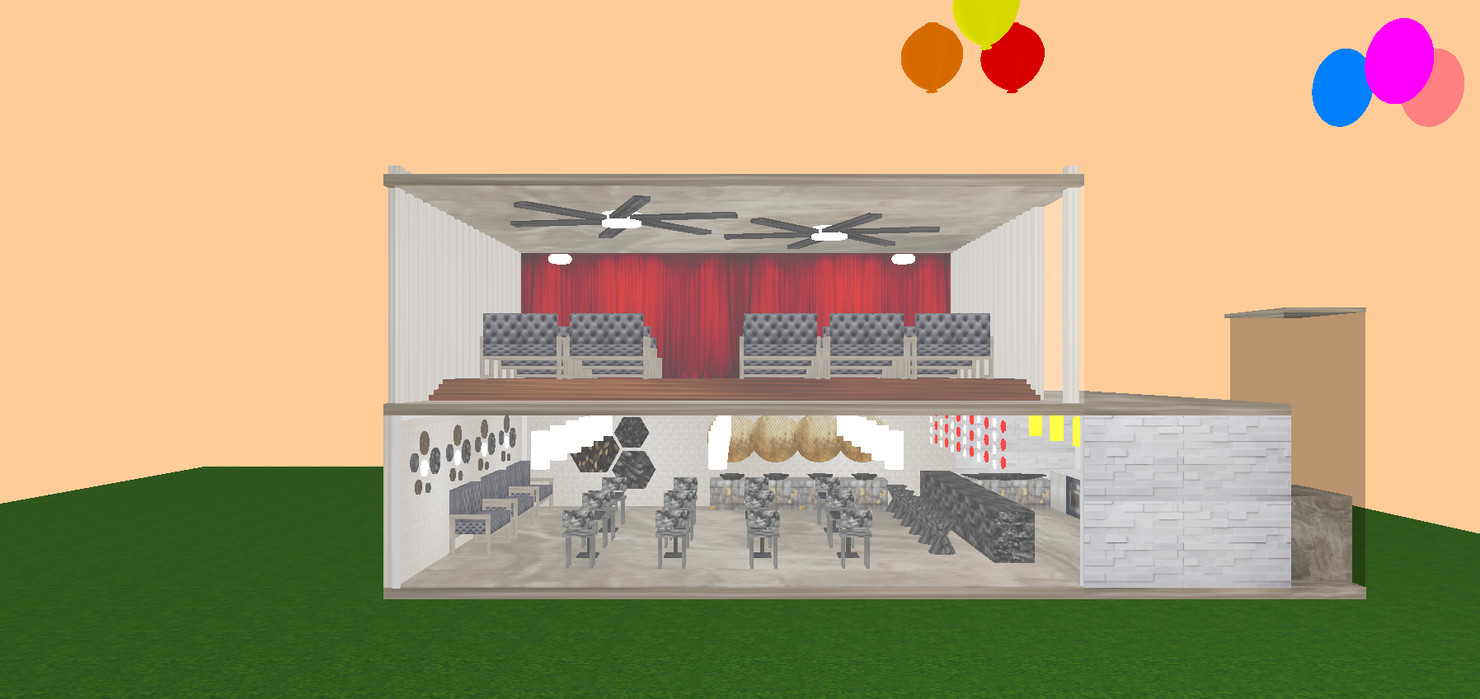
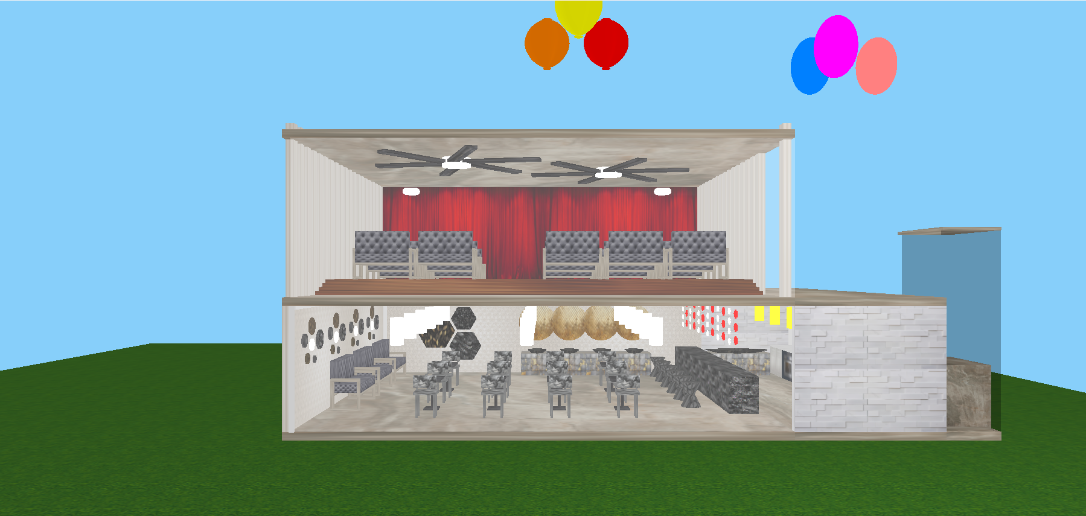
Features (Daylights)
Press B+1 for morning scene, B+2 for noon scene.
Fig 3.1: Morning Scene
Fig 3.2: Noon Scene

Slide 11
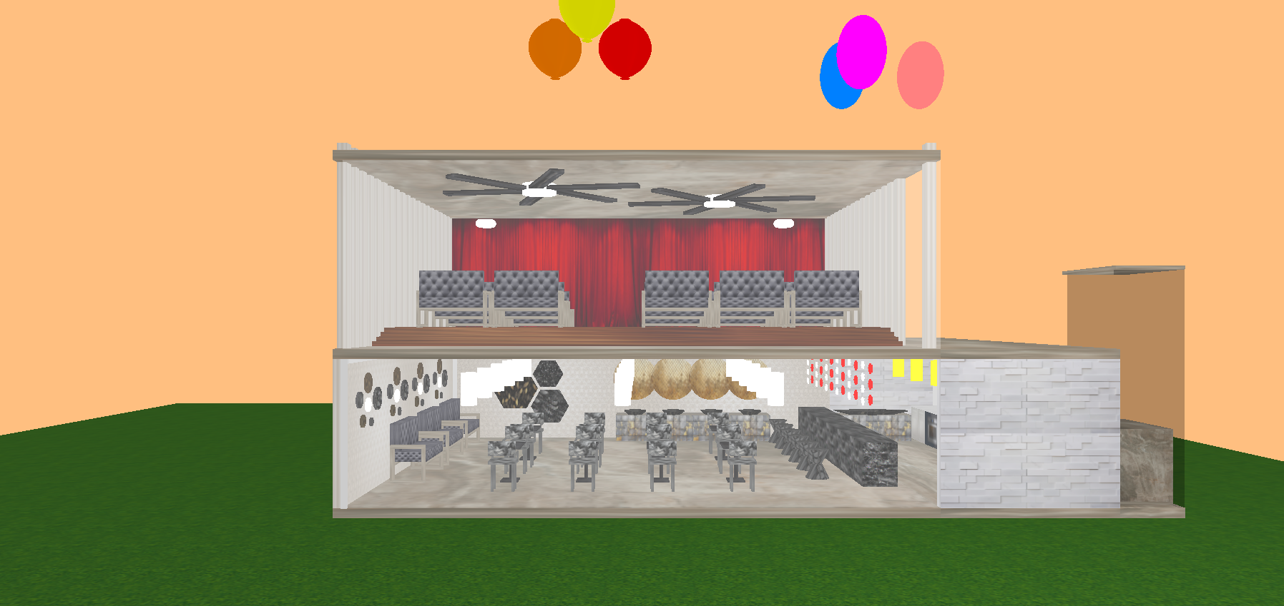
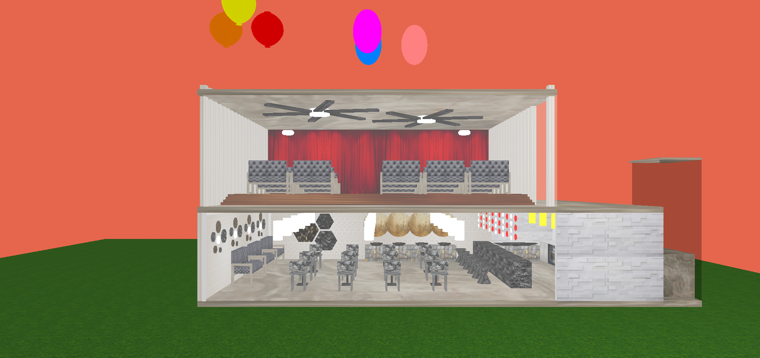
Features (Daylights) Cont’d
Press B+3 for afternoon scene, B+4 for evening scene.
Fig 3.3: Afternoon Scene
Fig 3.4: Evening Scene

Slide 12
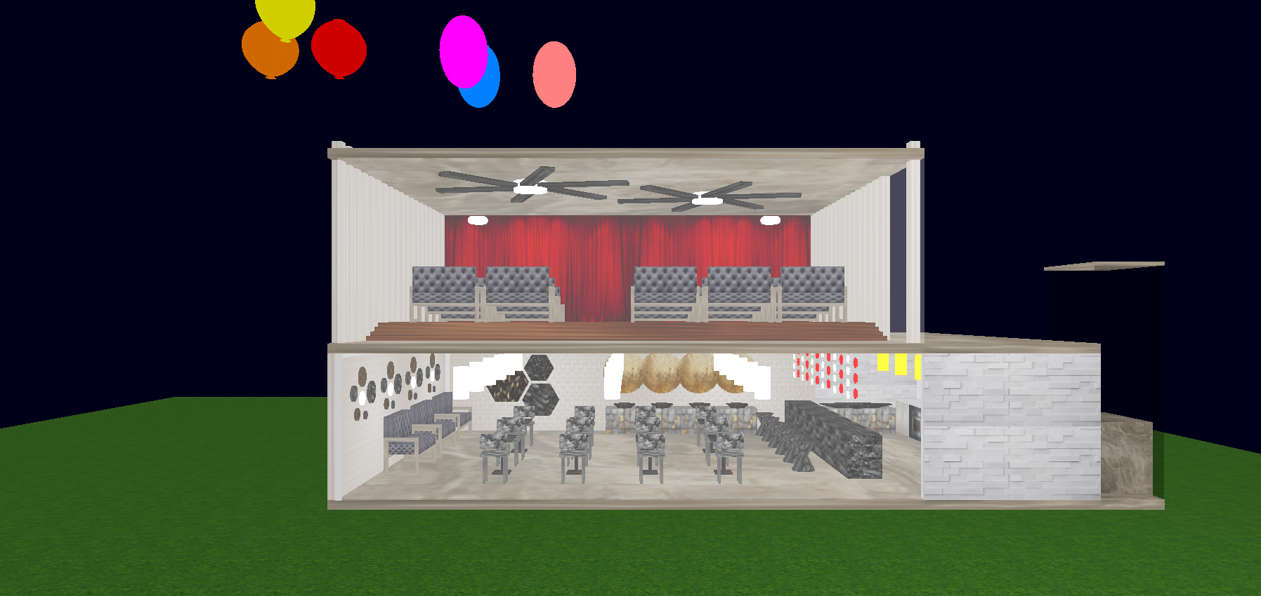
Features (Daylights) Cont’d
Press B+5 for night scene.
Fig 3.5: Night Scene

Slide 13
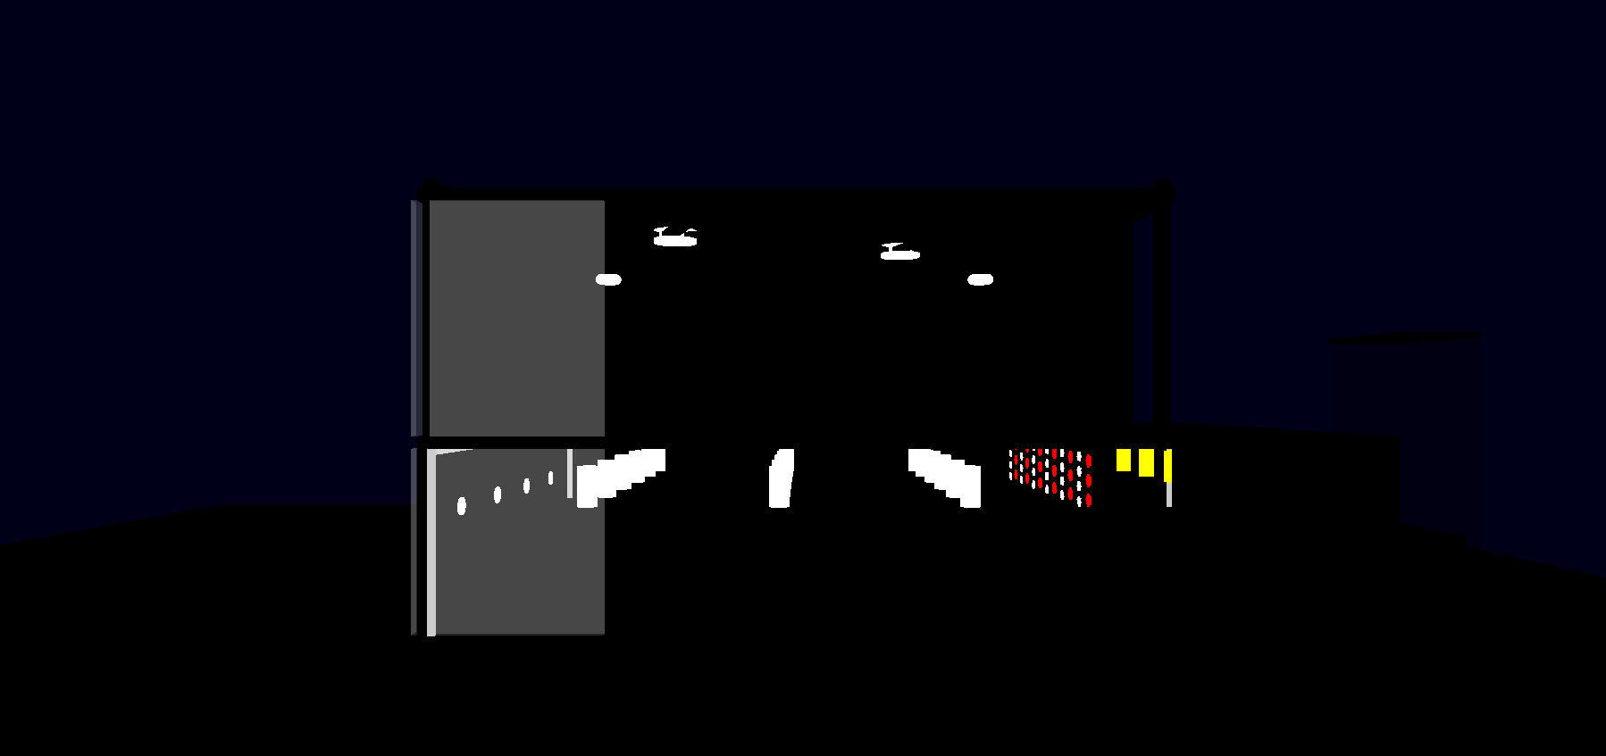
Features (Lighting)
Press L+1 to turn on all lights, B+2 to turn off all lights.
Fig 4.1: All lights on
Fig 4.2: All lights off

Slide 14
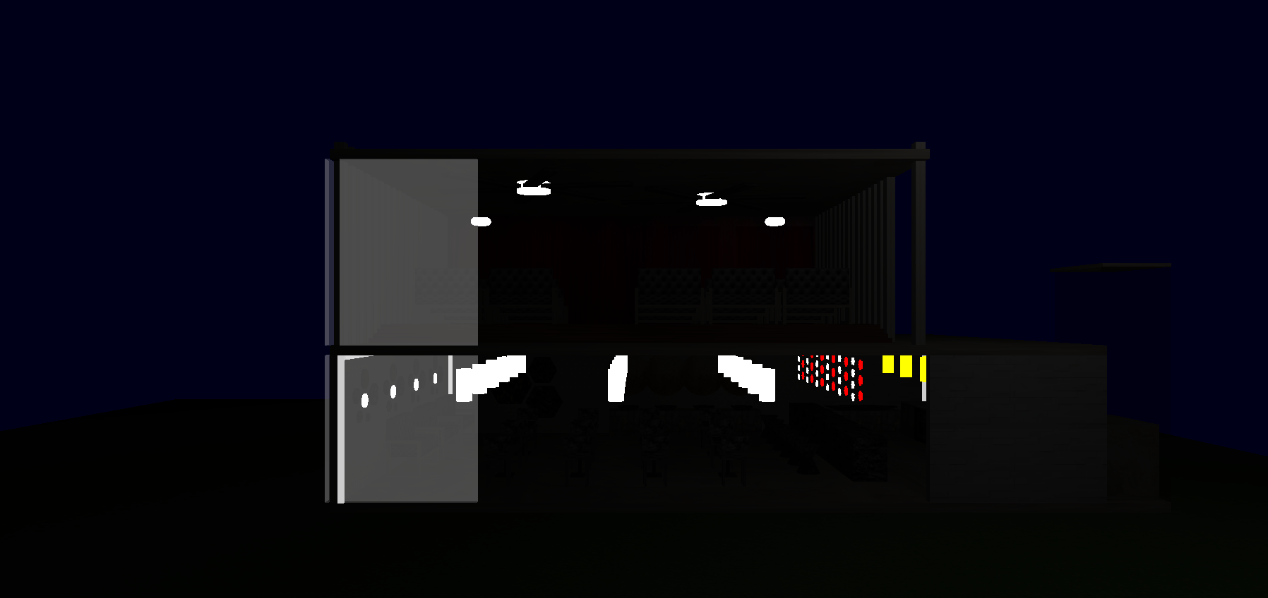
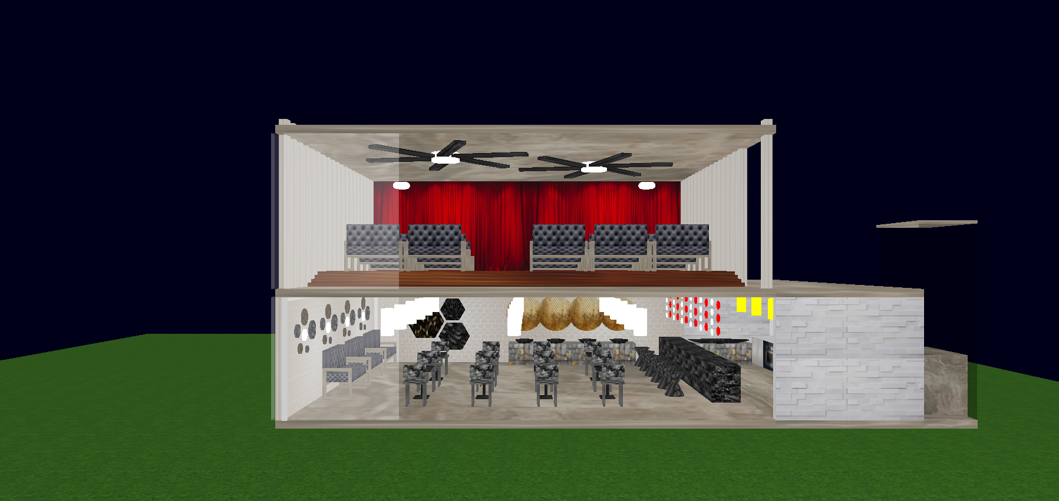
Features (Lighting) Cont’d
Press L+3 to turn on only the point lights (Spotlight and Directional light are off), L+4 to turn off only point lights (Spotlight and Directional light are on).
Fig 4.3: Only point lights on
Fig 4.4: Only point lights off

Slide 15

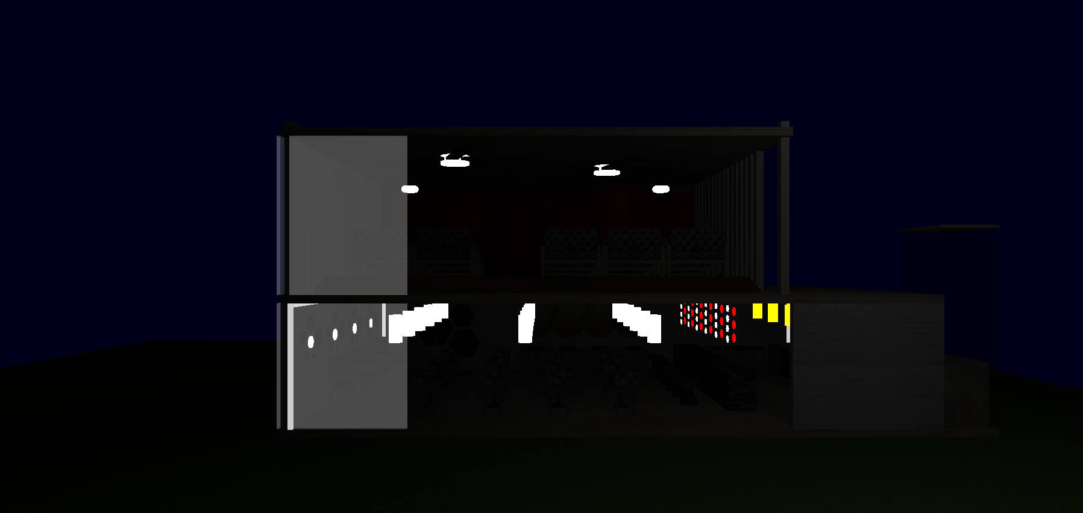
Features (Lighting) Cont’d
Press L+5 to turn on only directional light (Spotlight and point lights are off), L+6 to turn off only directional light (Spotlight and point lights are on).
Fig 4.5: Only directional light on
Fig 4.6: Only directional light off

Slide 16
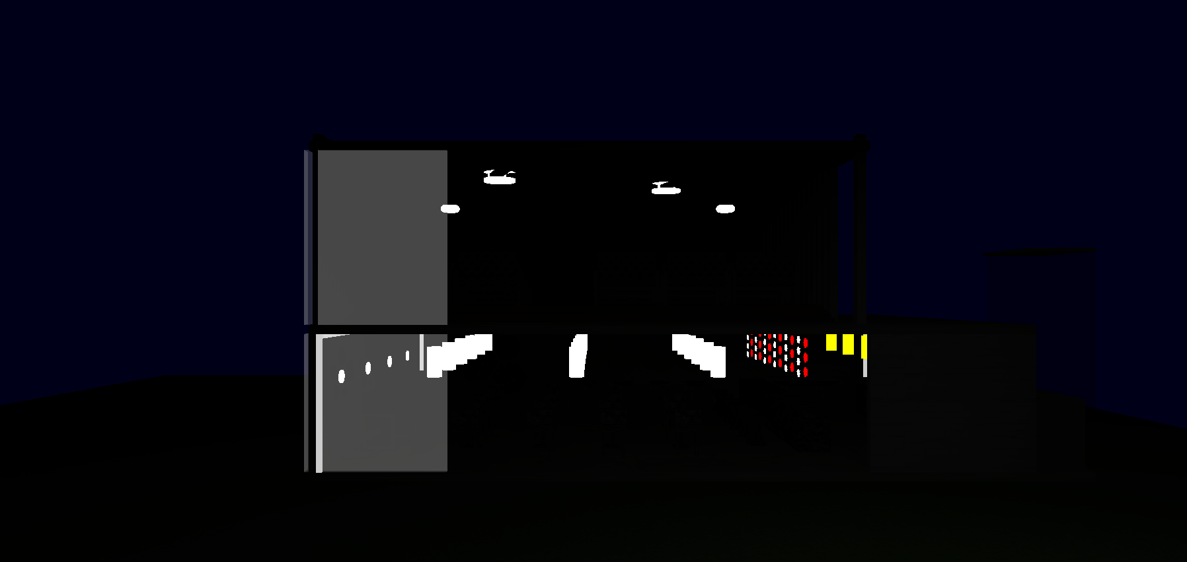
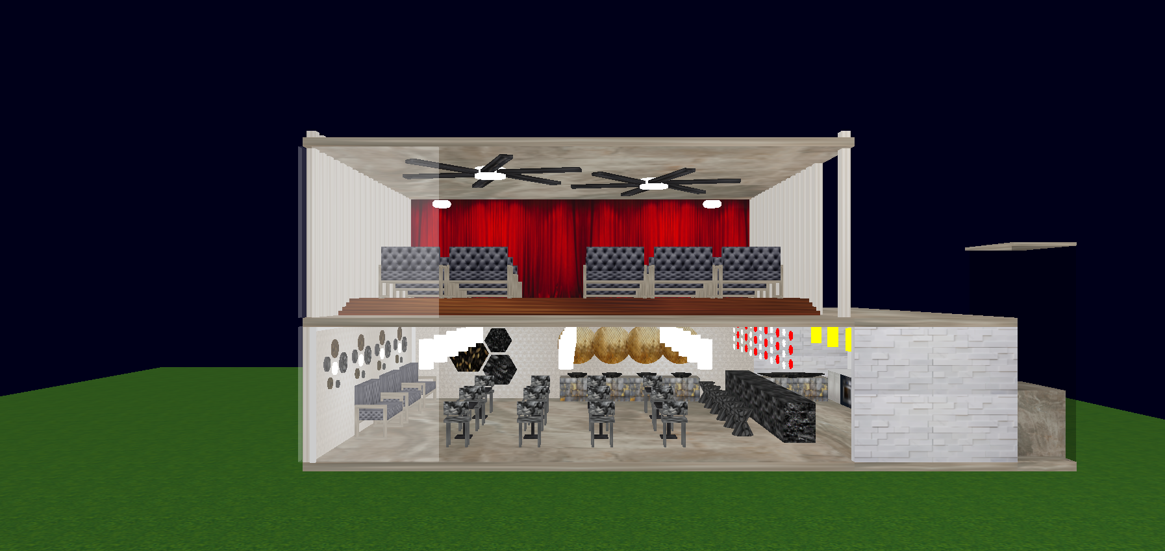
Features (Lighting) Cont’d
Press L+7 to turn on only spotlight (Directional light and point lights are off), L+8 to turn off only spotlight (Directional light and point lights are on)
Fig 4.7: Only spotlight on
Fig 4.8: Only spotlight off

Slide 17
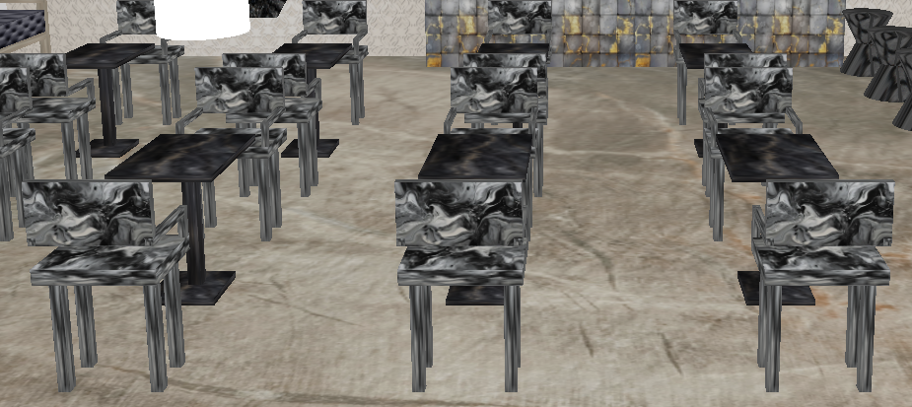
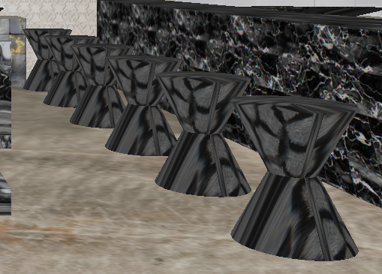
Features (Objects)
Chairs and tables are made of cubes, and tools are made of cubes.
Fig 5.1: Chair-Table
Fig 5.2: Tool

Slide 18
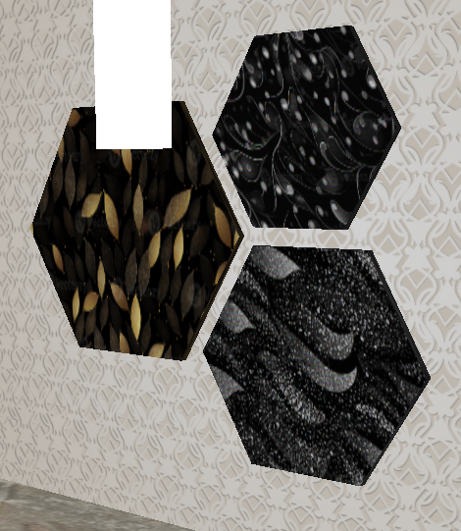
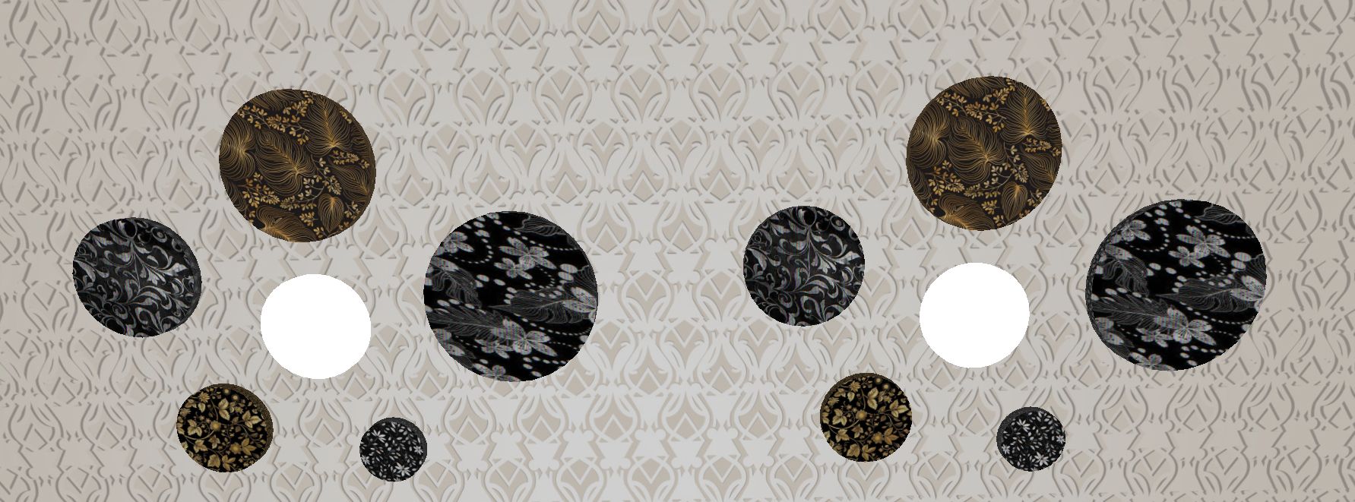
Features (Objects) Cont’d
Interior designs are made of hexagons and cylinders.
Fig 5.3: Interior design

Slide 19
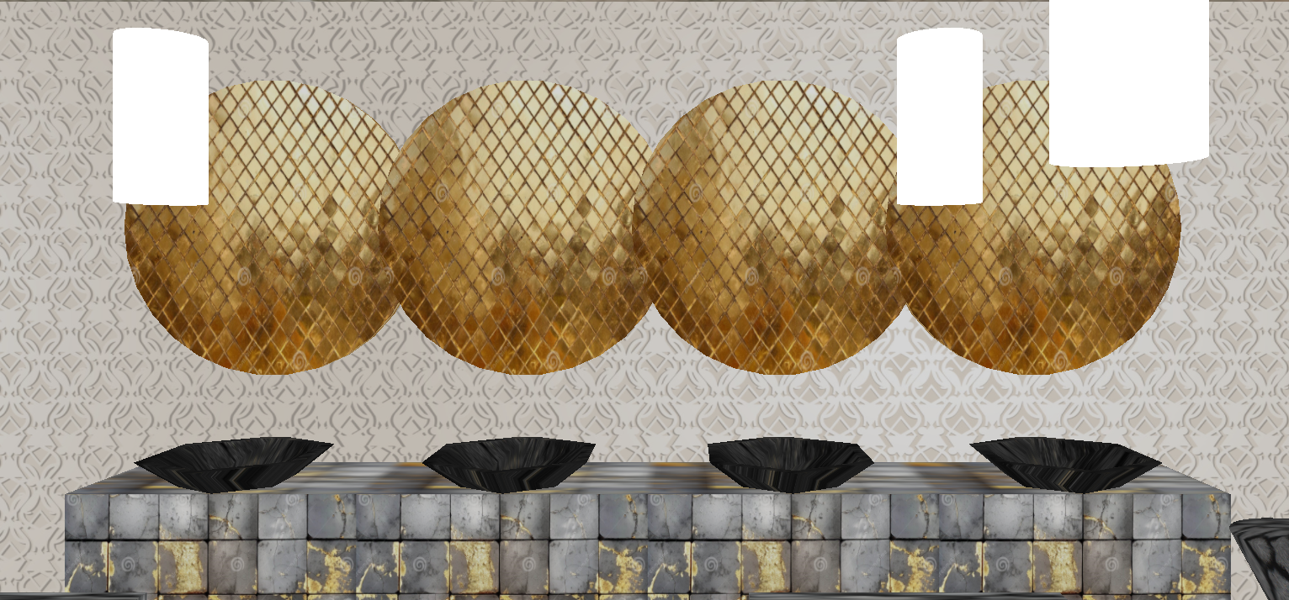
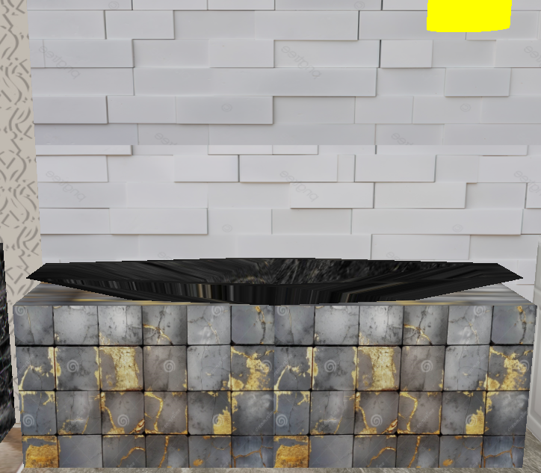
Features (Objects) Cont’d
Mirrors are made of cylinders, sinks are made of hollow hexagons and the kitchen sink is made of hollow pentagon.
Fig 5.4: Mirror and sink
Fig 5.5: Kitchen sink

Slide 20
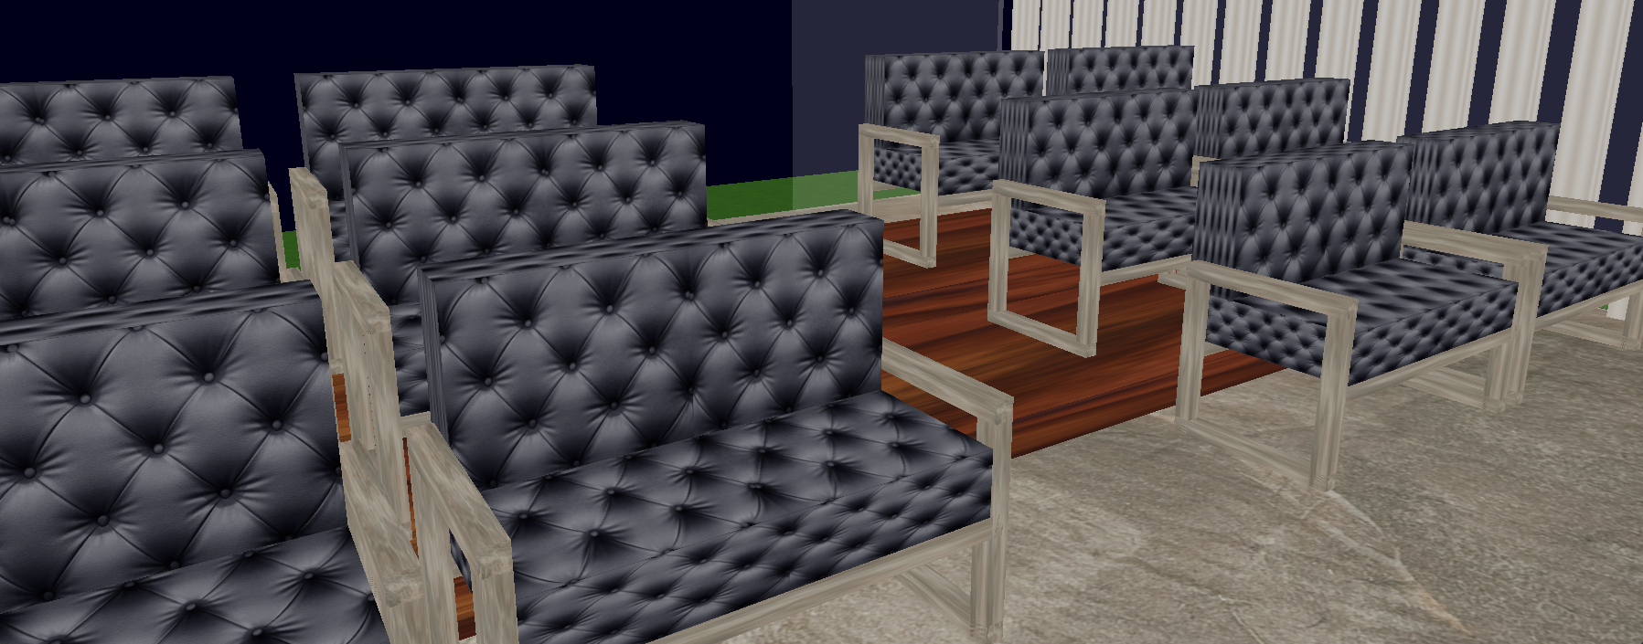
Features (Objects) Cont’d
Sofas and stairs are made of cubes.
Fig 5.6: Sofa and stair

Slide 21
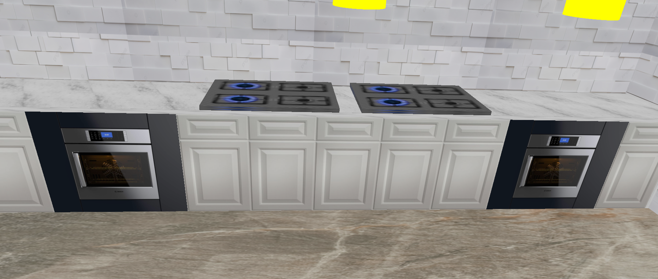
Features (Objects) Cont’d
Cabinets, stoves and microwave ovens are made of cubes with textures.
Fig 5.7: Kitchen

Slide 22
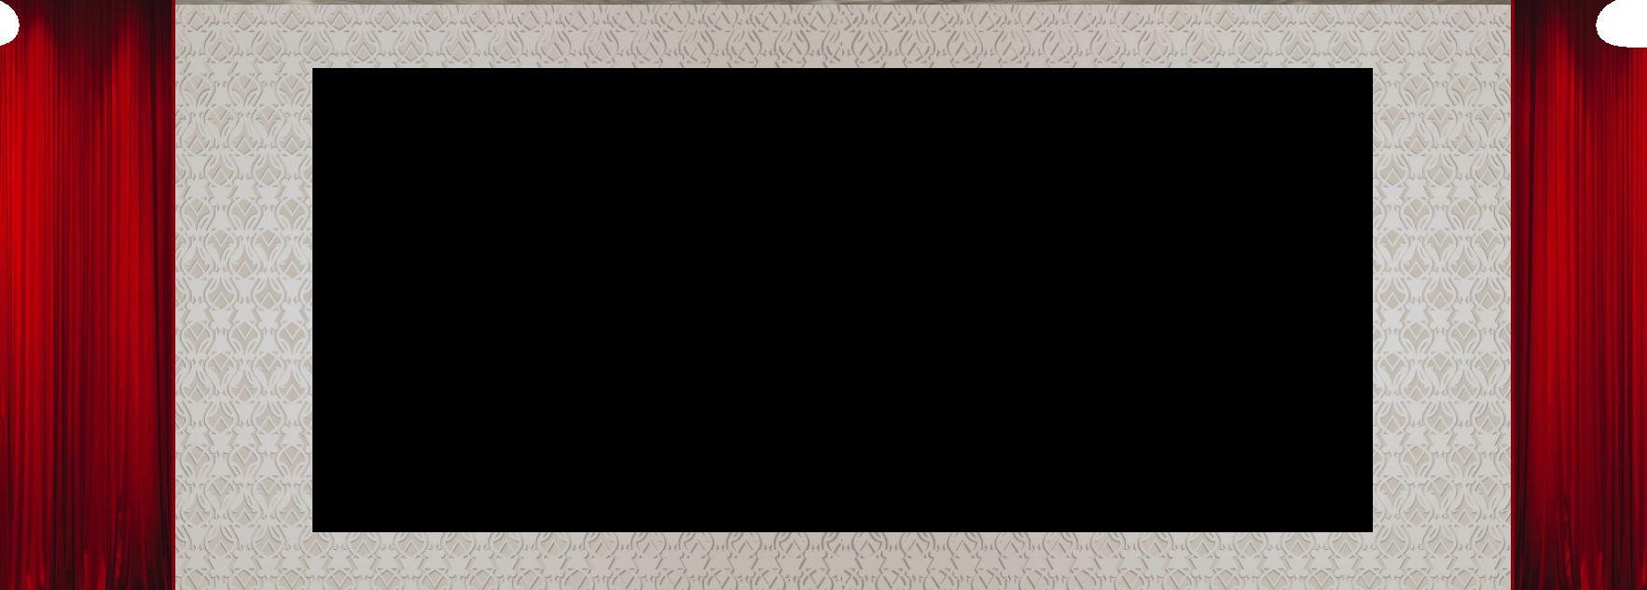
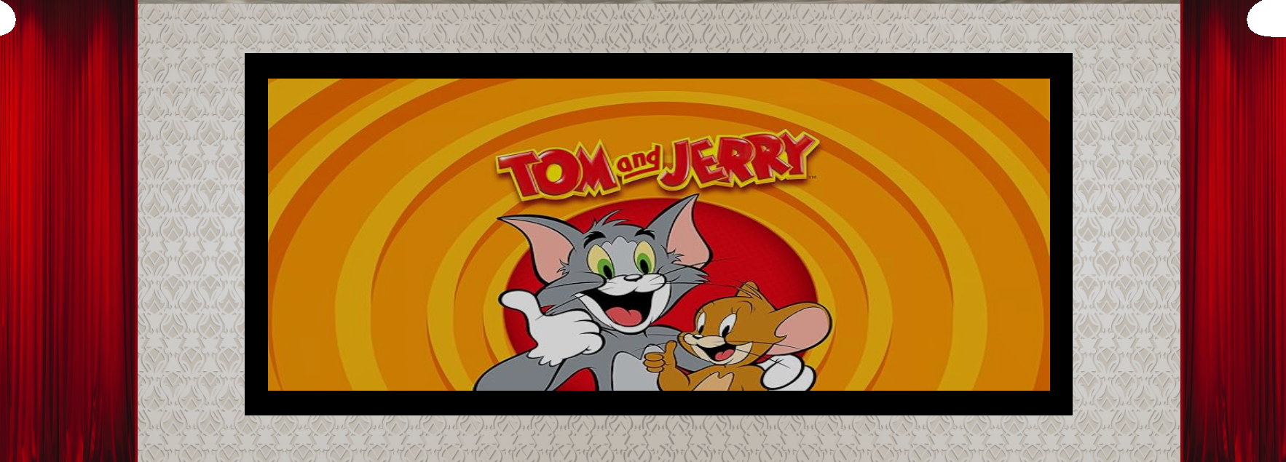
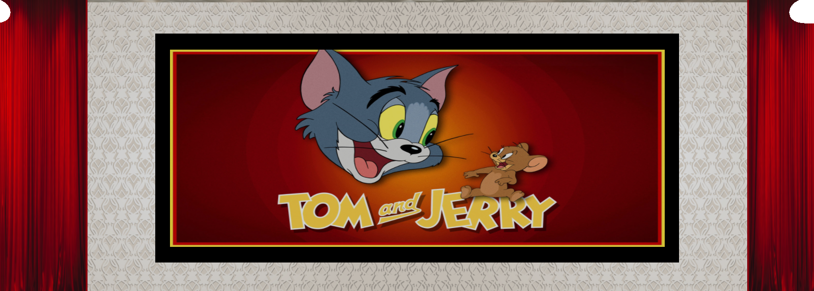
Features (Objects) Cont’d
Television is made of cubes and textures.
Fig 5.8: Television

Slide 23
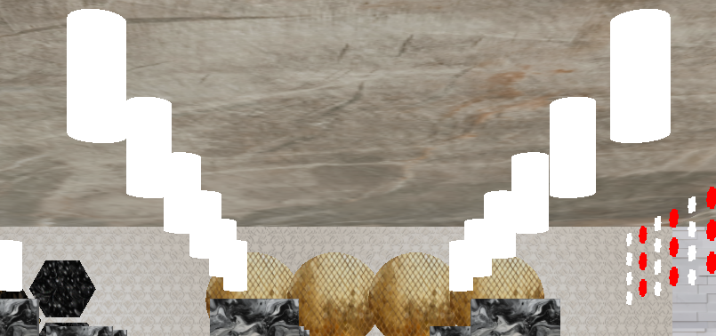
Features (Light Objects)
Cylinder lights.
Fig 6.1: Cylinder light

Slide 24
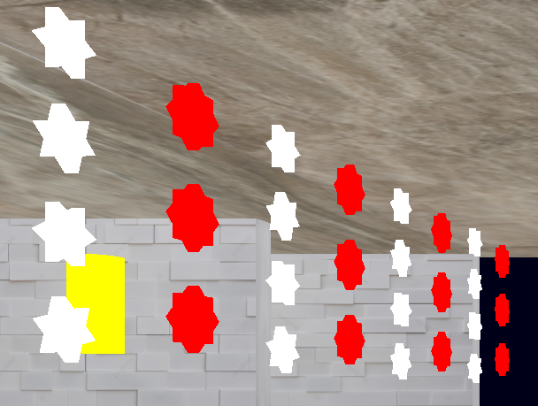

Features (Light Objects) Cont’d
Star lights are made of triangles and cubes, Torus light is made of cubes.
Fig 6.2: Star light
Fig 6.3: Torus light

Slide 25
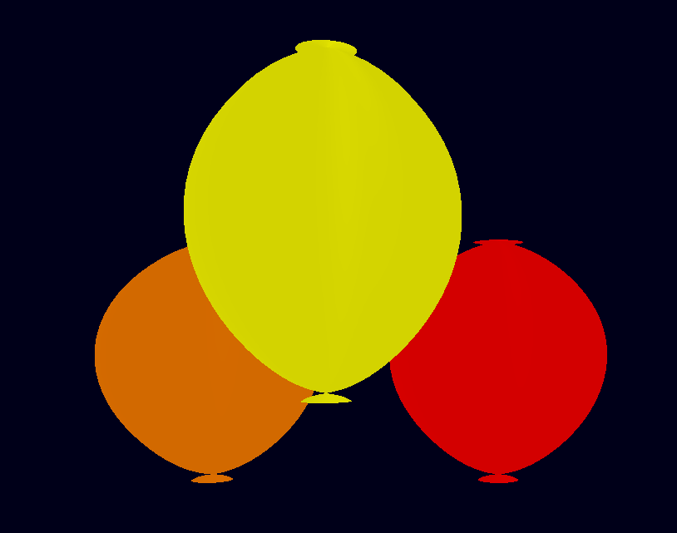
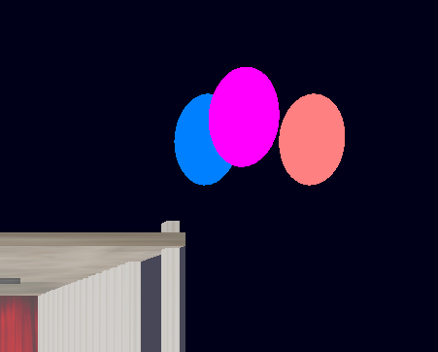
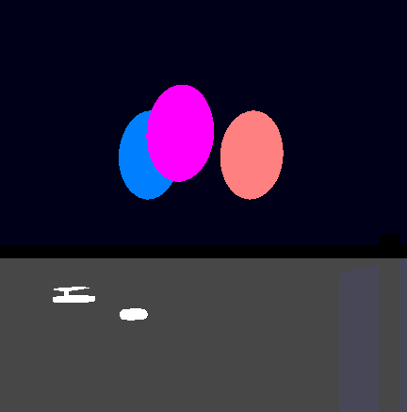
Features (Light Objects) Cont’d
Ballons are made of Bezier curve, Light ballons are made of spheres.
Fig 7.1: Ballon
Fig 7.2: Light ballon

Slide 26
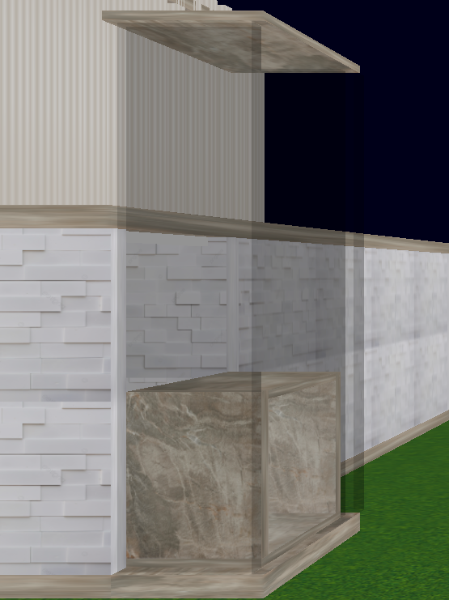
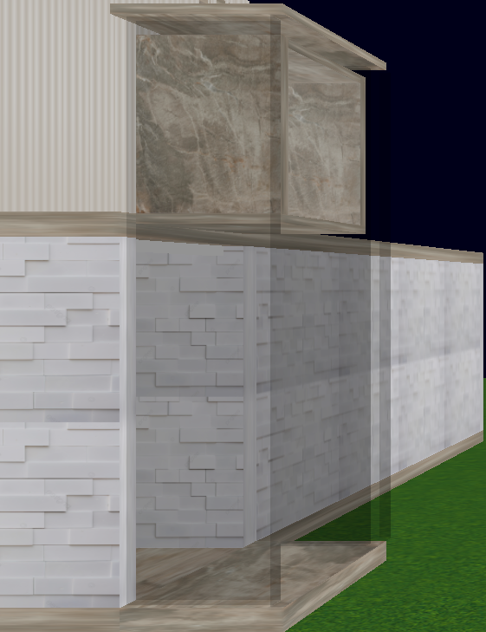
Features (Moving Object: Translation)
Press E+1 to go to the 1st floor, E+2 to go to the ground floor.
Fig 7.3: Lift on ground floor
Fig 7.4: Lift on first floor

Slide 27
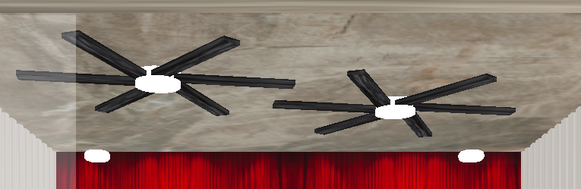
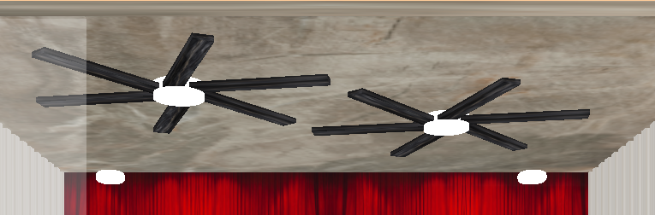
Features (Moving Object: Rotation)
Press F+1 to turn on the fan, F+2 to turn off the fan.
Fig 8.1: Fan off
Fig 8.2: Fan on

Slide 28
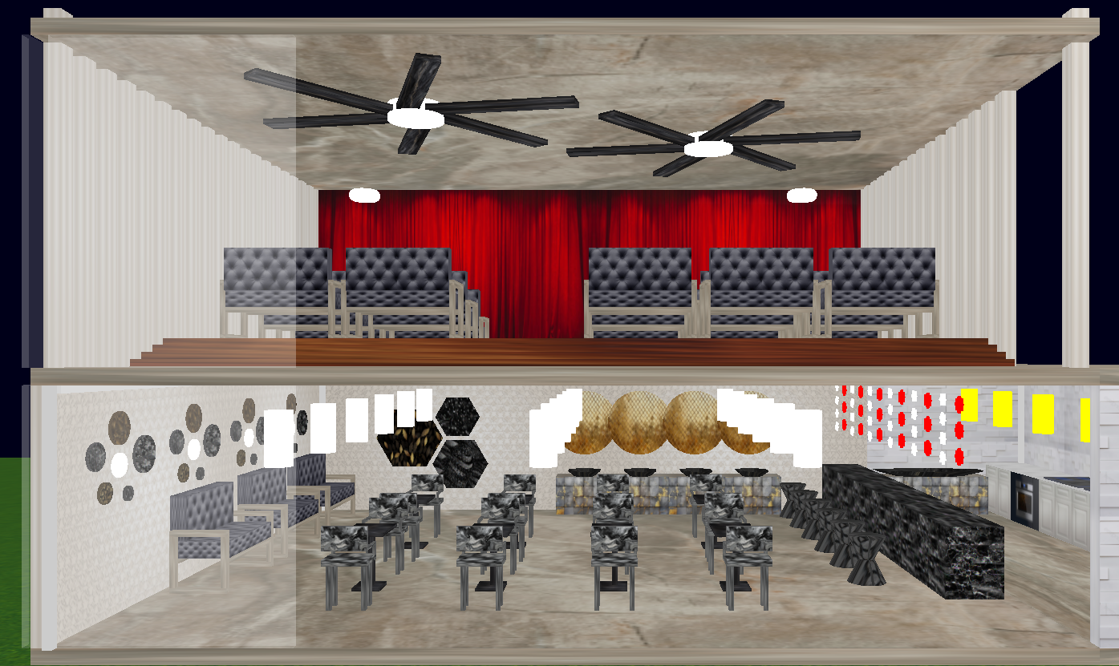
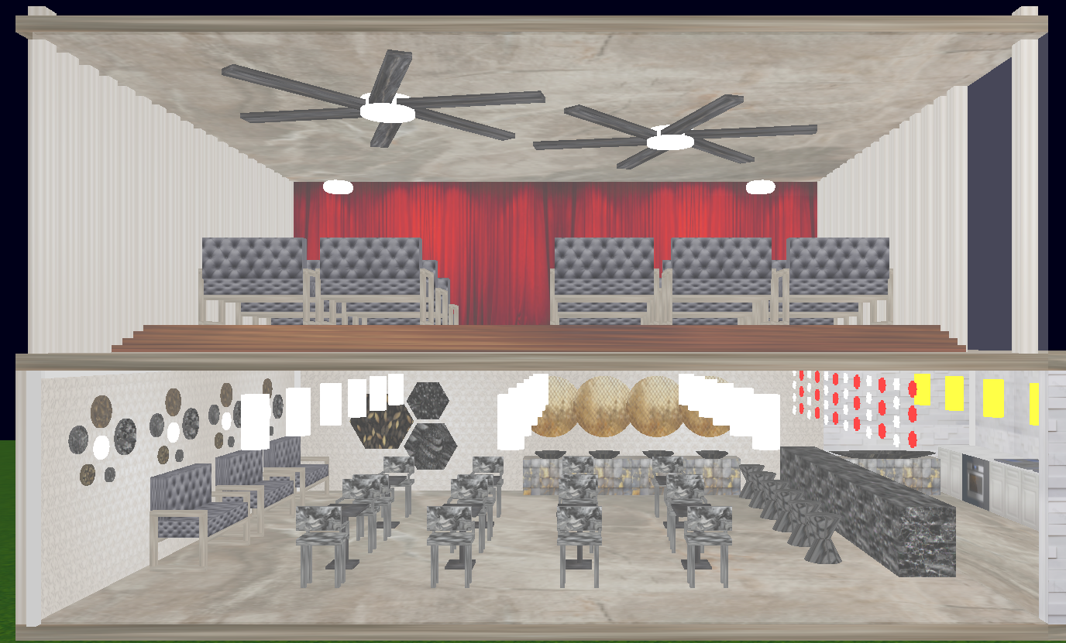
Features (Moving Objects: Scaling)
Press D+1 to open the cafeteria door, D+2 to close the cafeteria door. While opening, the door will bend, and go back. While closing, the door will bend, and go to the right side.
Fig 9.1: Cafeteria door opened
Fig 9.2: Cafeteria door closed

Slide 29
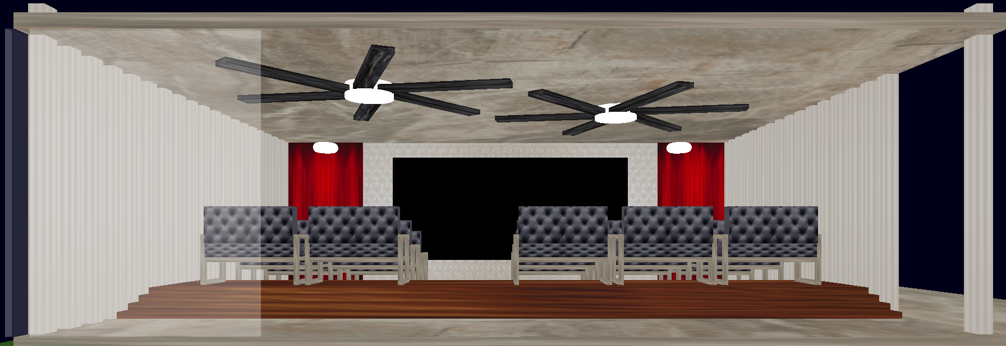
Features (Moving Objects: Scaling) Cont’d
Press C+1 to open the curtain door, C+2 to close the curtain.
Fig 9.3: Curtain opened
Fig 9.4: Curtain closed

Slide 30
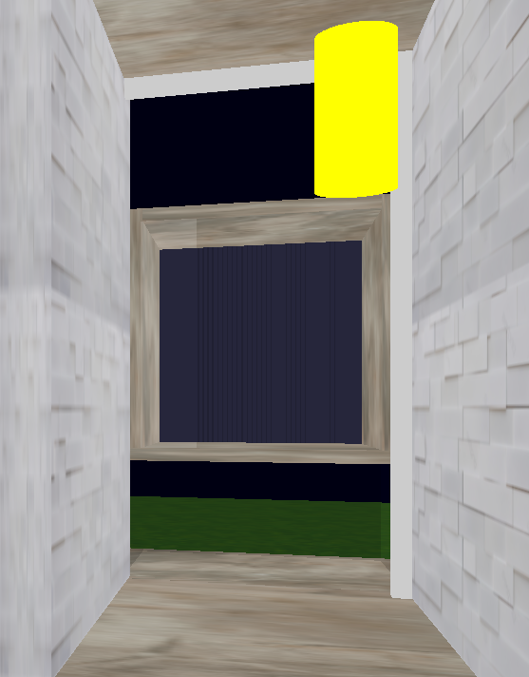
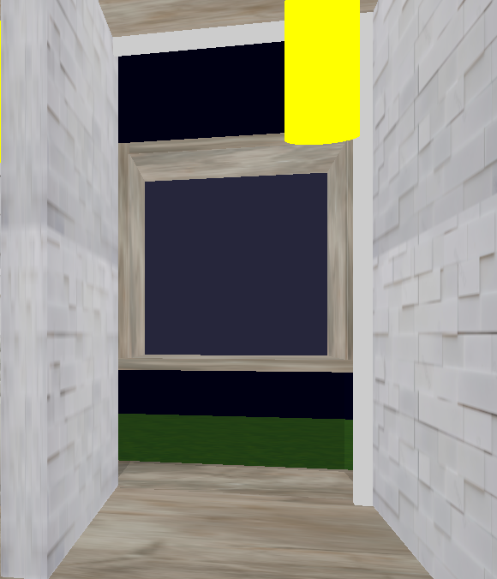
Features (Moving Objects: Scaling) Cont’d
Press O+1 to open the lift door, the door will be closed automatically.
Fig 9.5: Lift door opened
Fig 9.6: Lift door closed

Slide 31

Visual Representation of the Project

Slide 32
Conclusion
OpenGL 3.3 is a very powerful graphics library. This project was built using only the basic structures. But using Blender or any other 3D modeling software it can improved.
OpenGL 3.3 doesn’t provide any kind of physics engine. Even though in this project some physics has been implemented. But there are many physics libraries such as NVIDIA PhysX. Using them can be more interesting.

Slide 33
THANK YOU

